Slide 1
SIMPLEX METHOD FOR LP
LP Model
Presented By
Mr.M.Prasath
AP/Maths,
KIOT, Salem

Slide 2
Preview of the Simplex Method
Developed by G B Dantzig in 1947.
Similar to Graphical Method.
Simplex method examines the extreme points in a systematic manner , till we reach optimal solution .
Hence iterative in nature .

Slide 3
The Simplex algorithm
Strart with a feasible solution
Is it optimal ?
Quit with optimal solution
Unbounded solution
unbounded
Quit with unbounded solution

Slide 4
Slack Variable
For constraint of type the RHS normally represnts the limit on the avaliablity of resource
6X1+4X2 < 24
6X1+4X2 +S1 = 24
Where s is slack variable

Slide 5
Surplus Variable
For constraint of type the RHS normally represnts the limit on the avaliablity of resource
6X1+4X2 > 24
6X1+4X2 - S1 = 24
Where s is surplus variable

Slide 6
Example
Express the following in standard LP Model form
Max Z = 2x1+3x2+5x3
Subject to
X1+X2-X3 > 5
-6X1+7X2-9X3 < 4
X1,X2 > 0

Slide 7
Solution
The First constraint ahas a negative RHS which needs to be converted to positve by multipling both side by -1
Add slack s1 to First constraint
Add slack s2 to second constraint

Slide 8
Standard Form
Max Z = 2x1+3x2+5x3+0s1+0s2
Subject to
X1+X2-X3+s1 = 5
-6X1+7X2-9X3+s2 = 4
X1,X2 ,s2,s3 > 0

Slide 9
Steps in simplex method
Formulation of the mathematical model
Set up initial solution
Test for optimality
Select entering variable
Selecting the leaving Variable
Finding new Solution
Repeat the procedure

Slide 10
Testing for optimality
Calculate cj-zj for all non basic variables.
Examine value of cj-zj
The possible solution are
Cj-zj >0 then the BFS is optimal

Slide 11
INITIAL STEPS
Max Z = 2x1+3x2+5x3+0s1+0s2
Subject to
X1+X2-X3+s1 = 5
-6X1+7X2-9X3+s2 = 4
X1,X2 ,s2,s3 > 0

Slide 12
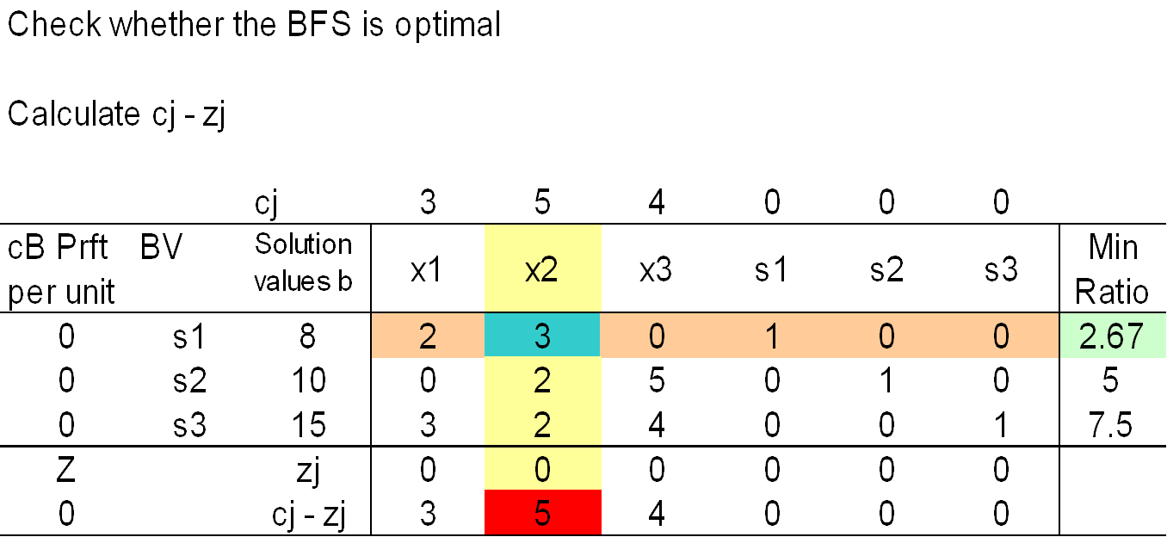
CHECK FOR OPTIMALITY

Slide 13
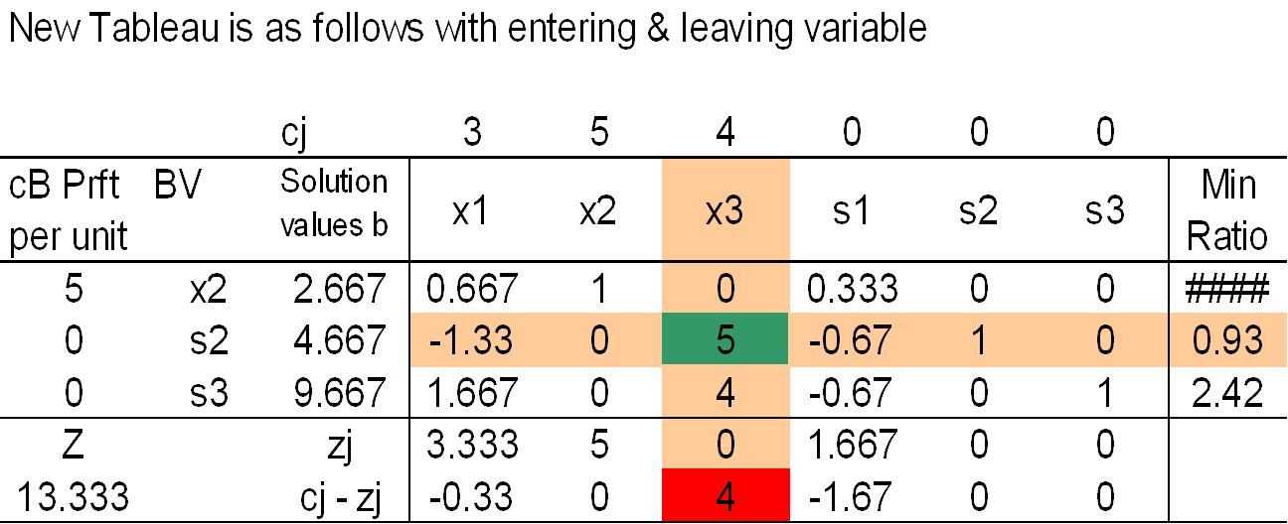
NEW TABLE

Slide 14
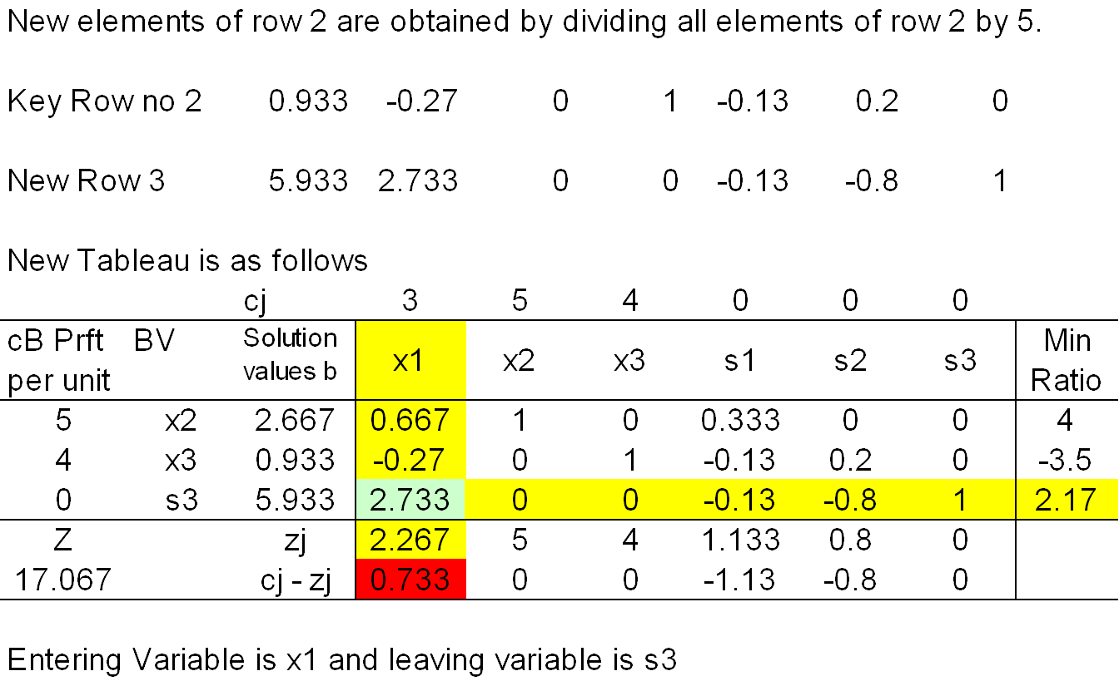
NEW ITERATION

Slide 15
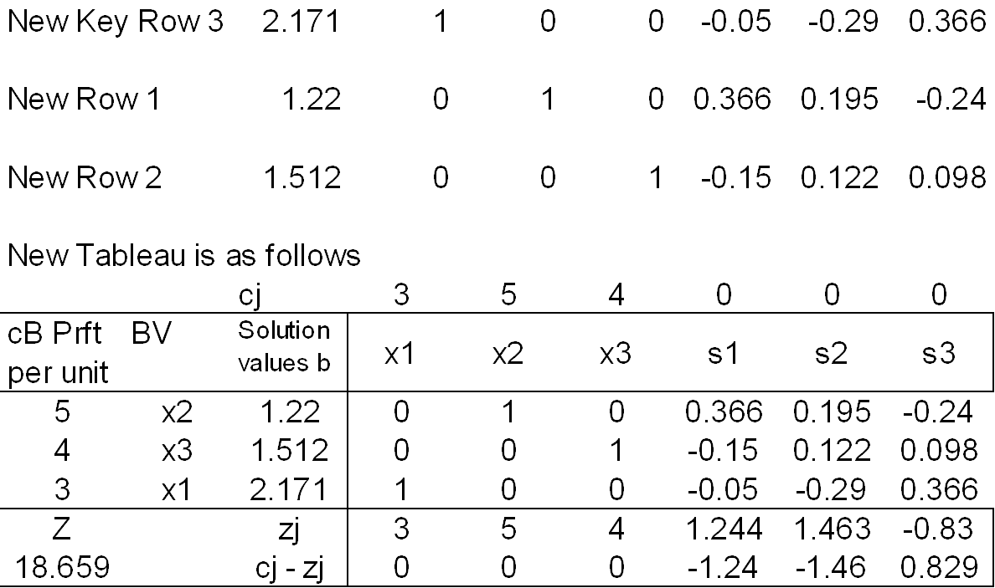

Slide 16
Basic Feasible solution
Every basic feasible solution of a linear program in standard form is a corner point solution .

